Slide 1
Introduction to Structured Programming
Types of errors, casting, ternary operators, and switch/case statements

Slide 2
Types of common errors
In programming, there are several types of errors that can occur:
Compiler errors
Runtime errors
Logic errors

Slide 3
Compiler errors
Compiler errors are generally the easiest to detect when using modern IDEs. These errors occur when the programmer makes a syntax error at the code level, and the compiler detects the error at compilation time. Here are some examples:
Forgetting to put ; at the end of a statement.
Using a variable without having declared it.
Incorrect spelling when referring to a variable.
Calling a function which has been defined, but which has no prototype (we will see this case later on).
Using a variable that has not been initialized. (It depends on the place where the variable is used).

Slide 4
Using variables without declaration
The following case will cause a compiler error:
#include <iostream>
using namespace std;
int main()
{
cout << "Value: " << value << endl;
system("pause");
return 0;
}

Slide 5
Using variables without declaration
The following case will cause a compiler error:
#include <iostream>
using namespace std;
int main()
{
int value = 5
cout << "Value: " << Value << endl;
system("pause");
return 0;
}

Slide 6
Using variables without initialization
If the value is used without initializing it before using it, there will be a compiler error:
#include <iostream>
using namespace std;
int main()
{
int value;
cout << "Value: " << value << endl;
system("pause");
return 0;
}

Slide 7
Runtime errors
Runtime errors occur during the execution of the code (at runtime). This type of error is often due to insufficient analysis of the different possible scenarios a program could end up facing:
Using a variable not initialized in all possible cases of the execution of code.
Dividing integers by 0.
Using null pointers (we will revisit this case).
Accessing regions of memory that the program is not authorized to access (common with pointers and arrays).

Slide 8
Using variables without initialization (with condition)
By contrast, in this case the error will not occur at compilation, but later, at execution.
The variable is initialized, but only if the bool variable isRaining is equal to true.
The compiler cannot detect this type of logical error:
#include <iostream>
using namespace std;
int main()
{
int value;
bool isRaining = false;
if (isRaining)
{
value = 5;
}
cout << "Value: " << value << endl;
system("pause");
return 0;
}

Slide 9
Dividing integers by 0
This will cause a runtime error:
#include <iostream>
using namespace std;
int main()
{
int value = 0;
cout << "Value: " << value / 0 << endl;
system("pause");
return 0;
}

Slide 10
Logic errors
Logic errors are the most difficult to detect and diagnose:
Using code structures without braces { }.
Using the symbol = in place of == when testing the condition of equality.
The ; symbol put in the wrong place.
Dividing real numbers by 0.
Loss of decimal precision.
Exceeding the value limits of a variable.

Slide 11
Using code structures without braces { }
In this example, we want to execute 2 instructions in a conditional structure, but this structure is not placed inside braces.
In this case, only the first instruction will be conditionally executed as part of the structure, and the other will always be executed.
#include <iostream>
using namespace std;
int main()
{
int value = 0;
if (value == 0)
cout << "The value = " << value << endl;
cout << "This message should be displayed from the if";
system("pause");
return 0;
}

Slide 12
Using = instead of == for equality test
In the following case, we will enter into the if statement, even if we should not:
#include <iostream>
using namespace std;
int main()
{
int valeur = 5;
if (valeur = 10)
{
cout << "This message will be displayed." << endl;
}
system("pause");
return 0;
}

Slide 13
The ; symbol put in the wrong place
In the following case, the message will be displayed! :
#include <iostream>
using namespace std;
int main()
{
int value = 5;
if (value == 10);
{
cout << "This message will be displayed." << endl;
}
system("pause");
return 0;
}

Slide 14
Dividing real numbers by 0
In the following case, the value dispalyed will not be a number. The value displayed will be inf:
#include <iostream>
using namespace std;
int main()
{
double value = 5;
value = value / 0;
cout << "Value = " << value << endl;
system("pause");
return 0;
}

Slide 15
Dividing real numbers by 0
In the following case, the value displayed will not be a number. The value displayed will be –nan(ind): [stands for: Not A Number (Is Not Defined)]
#include <iostream>
using namespace std;
int main()
{
double value = 0;
value = value / 0;
cout << "Value = " << value << endl;
system("pause");
return 0;
}

Slide 16
Loss of decimal precision
Unless we want precisely this behaviour, the following code will produce an unwanted loss of decimal precision:
#include <iostream>
using namespace std;
int main()
{
int a = 10, b = 3;
double result;
result = a / b;
cout << "Value = " << result << endl;
system("pause");
return 0;
}

Slide 17
Exceeding the min/max limits of a variable
When the maximum value of a type is exceeded, the value contained in the variable returns to the minimum value of the type.
Vice-versa in the case of exceeding the limits in the opposite direction:
#include <iostream>
using namespace std;
int main()
{
char c = 130;
cout << c << endl;
system("pause");
return 0;
}

Slide 18
Casting
When we want to transform the type of some data within a calculation, we can temporarily change its data type.
This is called casting.
The technique is to specify the desired type inside parentheses before the variable containing the data to be transformed.

Slide 19
Casting
Casting serves to force a type, specified at the level of the CPU, when performing a calculation/operation.
It does not apply any change to the data type of the variable subjected to casting. It only modifies how the CPU will perceive the variable for the brief instant that it is performing the calculation/operation.
For the moment, type casting will be used principally when we want to transform an int variable’s type into double, in cases where we need to divide integers and want to obtain a decimal result.

Slide 20
Review of certain important rules
When an arithmetic operation is applied, it is important to know which variable types will be used in the operation. The following rules apply:
If one or more variables used in the arithemetic operation is of a real number type (float, double, or long double), then the result produced by the operation will also be of a real number type.
If none of the variables used is of a real number type, then the result produced by the operation will be of an integer type. This point is very important to understand, especially for integer division, because this can cause a loss of decimal precision.

Slide 21
Examples (integer division)
#include <iostream>
using namespace std;
int main()
{
int a = 10, b = 3;
double result;
result = a / b;
cout << "The result is: " << result << endl;
system("pause");
return 0;
}

Slide 22
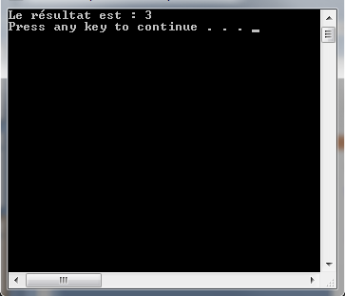
Examples (integer division)

Slide 23
Examples (real number division)
#include <iostream>
using namespace std;
int main()
{
double a = 10, b = 3;
double result;
result = a / b;
cout << "The result is: " << result << endl;
system("pause");
return 0;
}

Slide 24
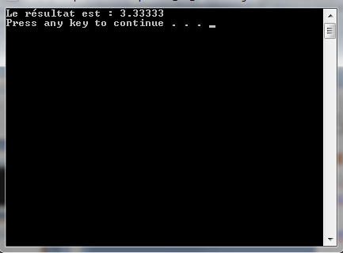
Examples (real number division)

Slide 25
Examples (integer division with casting)
#include <iostream>
using namespace std;
int main()
{
int a = 10, b = 3;
double result;
result = (double)a / b;
cout << "The result is: " << result << endl;
system("pause");
return 0;
}

Slide 26
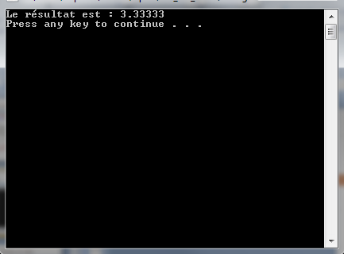
Examples (integer division with casting)

Slide 27
The ternary operator
In programming, the ternary operator is used to shorten code in cases of binary conditions specifying very short procedures/expressions.
The form of the ternary operator is as follows:
condition(s) ? expression1 : expression2
We read it like we read if/then/else conditional structures
IF the condition is true (conditions are true) THEN evaluate/use expression1 ELSE evaluate/use expression2
For example, let’s take the following code:

Slide 28
The ternary operator
#include <iostream>
using namespace std;
int main()
{
int val1;
cout << "Enter a numerical value: ";
cin >> val1;
if (val1 > 0 && val1 < 10) {
val1 = val1 * 10;
} else {
val1 = val1 + 10;
}
cout << "Value of val1 = " << val1 << endl;
system("pause");
return 0;
}

Slide 29
The ternary operator
We can shorten the code with the ternary operator:
#include <iostream>
using namespace std;
int main()
{
int val1;
cout << "Enter a numerical value: ";
cin >> val1;
val1 = (val1 > 0 && val1 < 10) ? val1 * 10 : val1 + 10;
cout << "Value of val1 = " << val1 << endl;
system("pause");
return 0;
}

Slide 30
The ternary operator
We can push even further:
#include <iostream>
using namespace std;
int main()
{
int val1;
cout << "Enter a numerical value: ";
cin >> val1;
cout << "Value of val1 = " << ((val1 > 0 && val1 < 10) ? val1 * 10 : val1 + 10) << endl;
system("pause");
return 0;
}

Slide 31
The ternary operator
It’s very practical for giving a more conversational sense to a certain variable value.
Here is an example without:
#include <iostream>
using namespace std;
int main()
{
bool isRaining = false;
cout << "Is it raining?: " << endl;
cout << isRaining << endl; // displays 0
system("pause");
return 0;
}

Slide 32
The ternary operator
It’s very practical for giving a more conversational sense to a certain variable value.
Here is an example with:
#include <iostream>
using namespace std;
int main()
{
bool isRaining = true;
cout << "Is it raining?: " << endl;
// displays "Yes":
cout << (isRaining ? "Yes" : "No") << endl;
system("pause");
return 0;
}

Slide 33
switch/case
The switch/case statement allows us to structure code that uses a conditional structure containing a series of multiple equality condition tests.
Moreover, it is useful when multiple different procedures could be executed, depending on the value of a single variable of an integer type.
The format is:
switch (<integer variable>)
{
case <constant integer value 1> :
procedure1
case <constant integer value 2> :
procedure2
…
default:
defaultProcedure
}

Slide 34
switch/case
For switch/case statements, there are certain rules to respect in C++:
The variable evaluated in the switch must have an integer value.
There must be at least one statement in one of the cases or in the default.
The comparison values for each case must be constant integer values.
It is not possible to declare a variable in a case.
The condition for entering into a case is always a test of equality (==). This does not need to be written; it is implicit.
When the condition of a case turns out to be true, the procedure for that condition will be executed, as well as all the other procedures that come after, until a break; (or return;) command is evaluated.
Let’s take the following example:

Slide 35
switch/case (example without)
#include <iostream>
using namespace std;
int main()
{
int a = 2;
if (a == 0) {
cout << "case 0" << endl;
} else if (a == 1) {
cout << "case 1" << endl;
cout << "case 2" << endl;
} else if (a == 2) {
cout << "case 2" << endl;
} else {
cout << "default case" << endl;
}
return 0;
}

Slide 36
switch/case (example with)
#include <iostream>
using namespace std;
int main()
{
int a = 2;
switch (a)
{
case 0:
cout << "case 0" << endl;
break;
case 1:
cout << "case 1" << endl;
case 2:
cout << "case 2" << endl;
break;
default:
cout << "default case" << endl;
break;
}
return 0;
}

